Slide 1
COFFEE SALES ANALYSIS
SQL AND POWER BI ANALYSIS

Slide 2
Link of coffee sales data
https://docs.google.com/spreadsheets/d/19KgEh7QVbczZhUhIc2ulb9Y1LWNc2NGE/edit?usp=sharing&ouid=108098947402480535330&rtpof=true&sd=true

Slide 3


TOTAL SALES ANALYSIS
Total sales

Slide 4
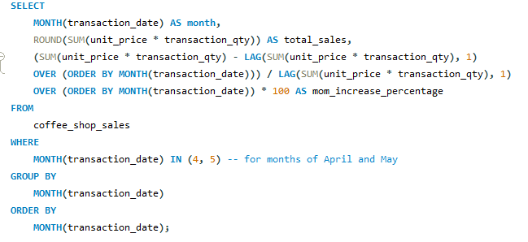
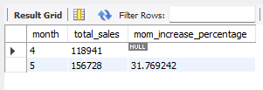
TOTAL SALES ANALYSIS
TOTAL SALES KPI - MOM DIFFERENCE AND MOM GROWTH

Slide 5


TOTAL SALES ANALYSIS
TOTAL ORDERS

Slide 6
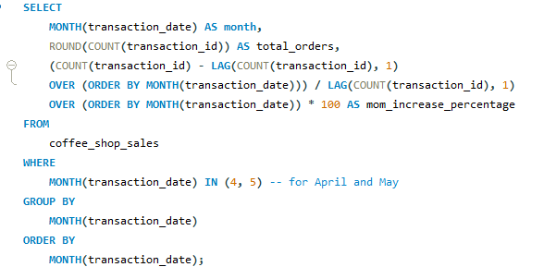

TOTAL SALES ANALYSIS
TOTAL ORDERS KPI - MOM DIFFERENCE AND MOM GROWTH

Slide 7


TOTAL SALES ANALYSIS
TOTAL QUANTITY SOLD

Slide 8
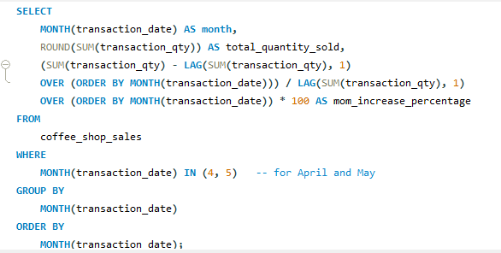
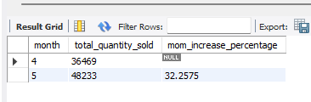
TOTAL SALES ANALYSIS
TOTAL QUANTITY SOLD KPI - MOM DIFFERENCE AND MOM GROWTH

Slide 9
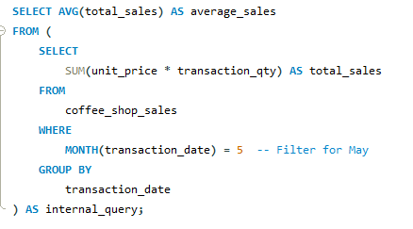

SALES TREND OVER PERIOD

Slide 10
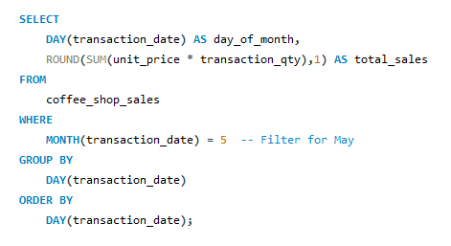
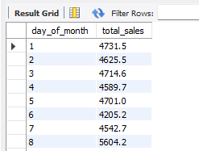
DAILY SALES FOR MONTH SELECTED

Slide 11
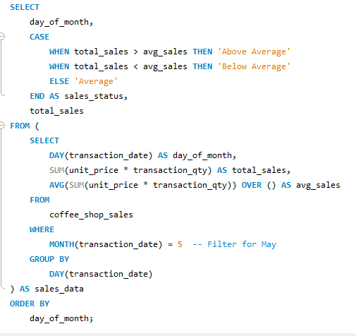
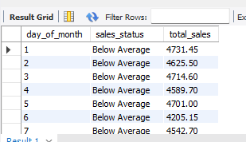
COMPARING DAILY SALES WITH AVERAGE SALES – IF GREATER THAN “ABOVE AVERAGE” and LESSER THAN “BELOW AVERAGE”

Slide 12
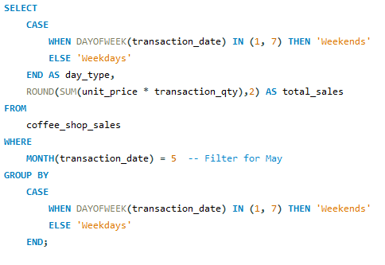
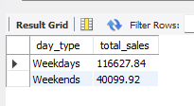
SALES BY WEEKDAY / WEEKEND

Slide 13
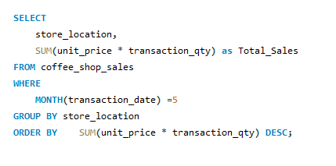
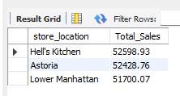
SALES BY STORE LOCATION

Slide 14
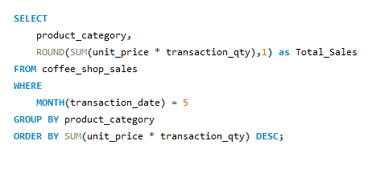
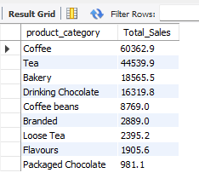
SALES BY PRODUCT CATEGORY

Slide 15
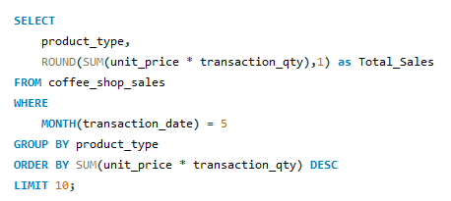
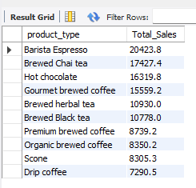
SALES BY PRODUCTS (TOP 10)

Slide 16
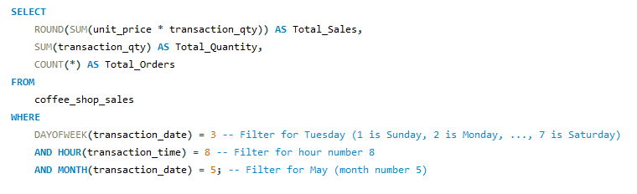

SALES BY DAY | HOUR

Slide 17
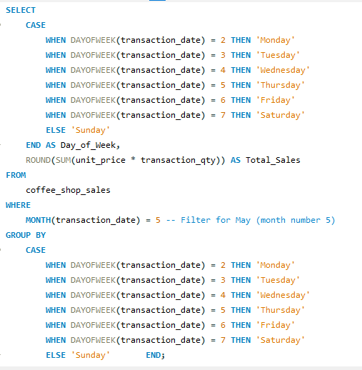
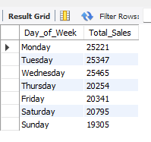
TO GET SALES FROM MONDAY TO SUNDAY FOR MONTH OF MAY

Slide 18
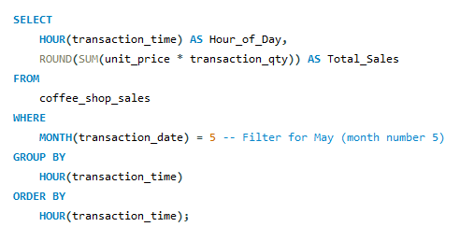
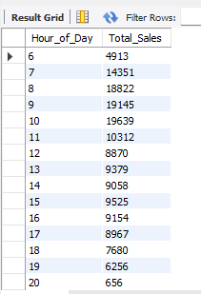
TO GET SALES FOR ALL HOURS FOR MONTH OF MAY

Slide 19
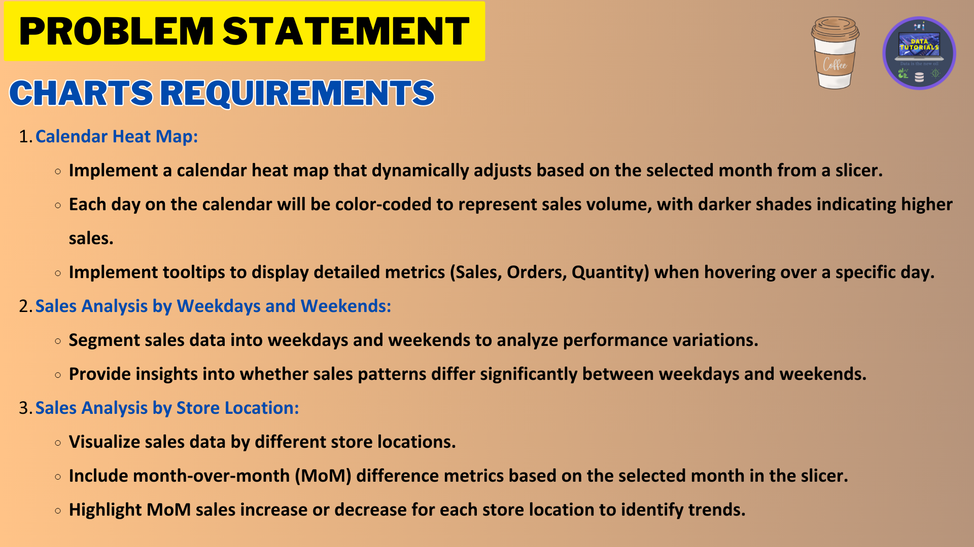

Slide 20
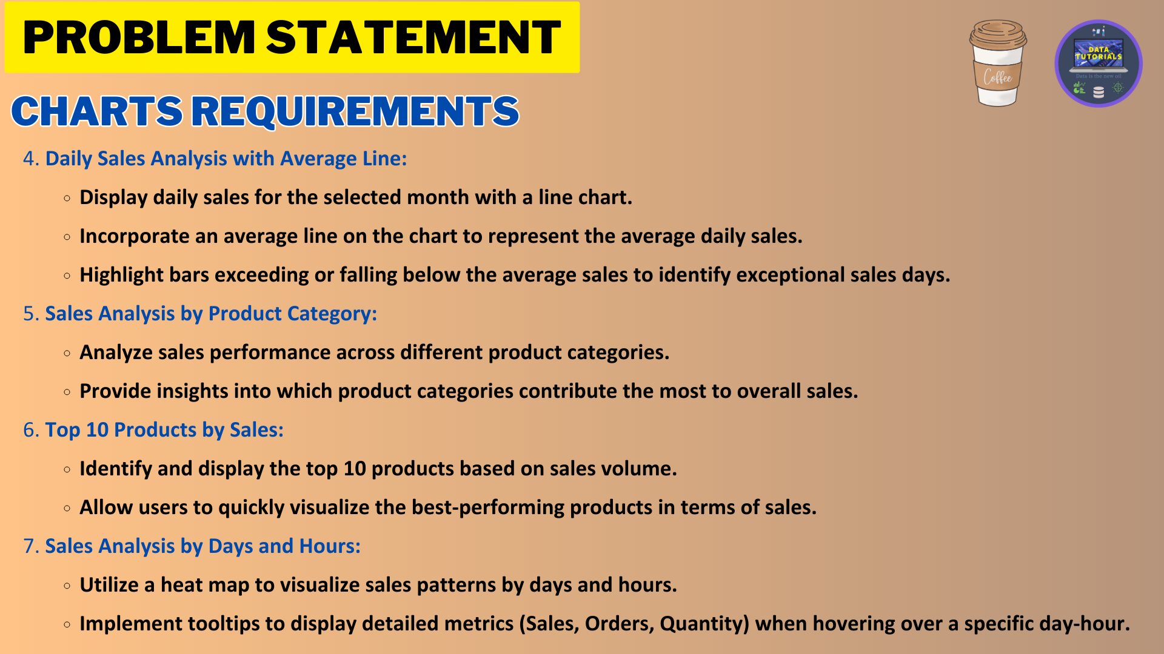

Slide 21
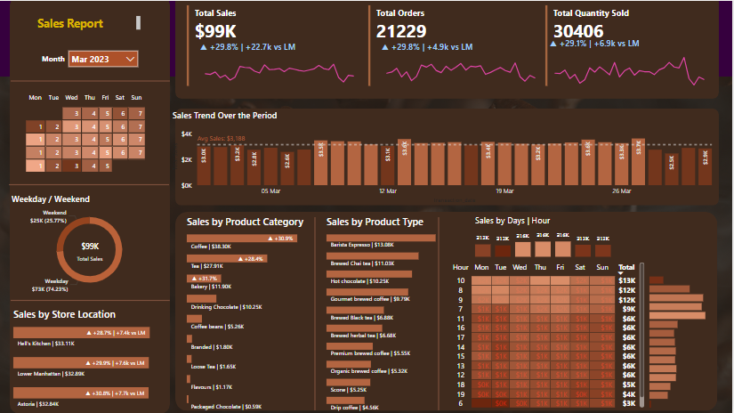

Slide 22


